Slide 1


Mac Installation & Activation -Basic Troubleshooting-

Slide 2
Topics to be covered
Mac Terminology
Office for Mac Installation & Activation
Uninstall Office from Mac
Office Removal Tools for Mac
Troubleshooting signing-in issues using Mac’s Keychain tool.

Slide 3

Mac Terminology

Slide 4
About Mac users…
MacOS has its own way of naming things. Something that we need to keep in mind is that many Mac users are fans of the Apple products they own, therefore some of them may feel uncomfortable if we do not name things correctly.
The next slide will display some components of the MacOS user interface and its closest equivalent found in a Windows system.

Slide 5
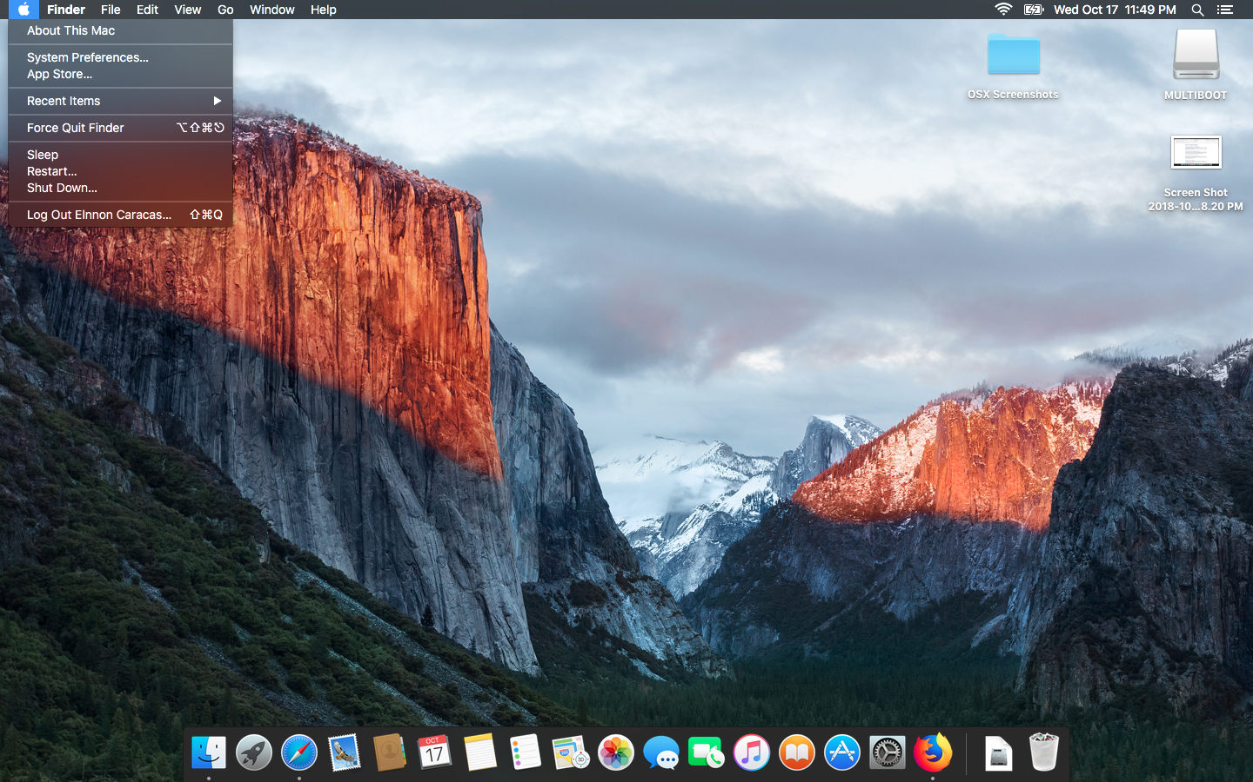
The MacOS Desktop

Slide 6


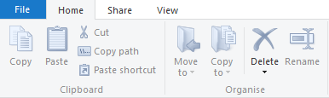


Mac Item
Windows Equivalent
Finder
Application Menu
Dock
Windows Explorer
Ribbon Menu
Taskbar

Slide 7

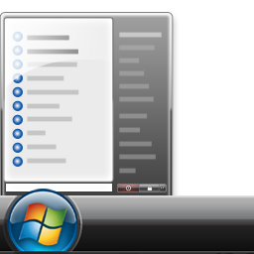




Mac Item
Windows Equivalent
Launchpad
Alias
System Preferences
Start Menu
Shortcut
Control Panel

Slide 8




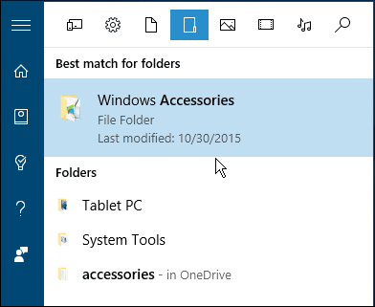


Mac Item
Windows Equivalent
Terminal
Utilities
Trash can
Command Prompt/PowerShell
Windows Accessories
Recycle bin

Slide 9



Mac Item
Windows Equivalent
Control (Ctrl) key (⌃)
Alt/Option key (⌥)
Command key
Control (Ctrl)
Alt key
Windows Logo key

Slide 10


Office for Mac Installation

Slide 11

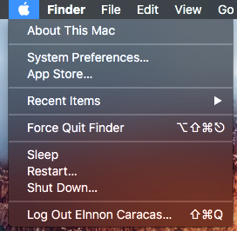
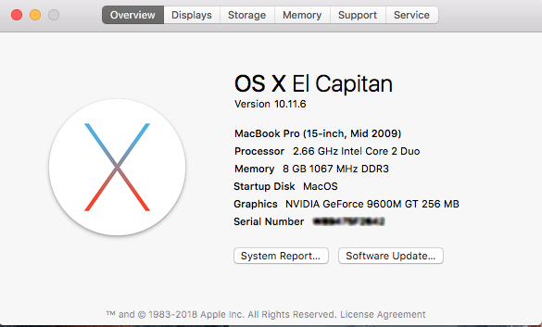
1. Check the MacOS version
Supported MacOS Versions:
Office 2019 & 365: MacOS 10.12 “Sierra” and above.
Office 2016 & 365: MacOS 10.10 “Yosemite” to 10.13 “High Sierra”
You can achieve this by going to the apple ( )icon, and selecting the option “About this Mac”

Slide 12
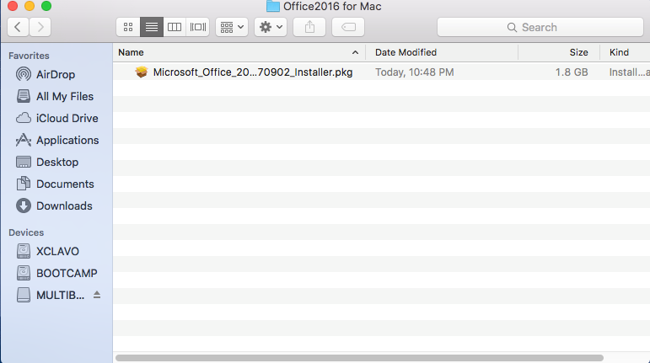
2. Get the Office for Mac Installer
Sign in to customer’s account through https://account.microsoft.com and download the installer through the “Services and Subscriptions” tab.

Slide 13
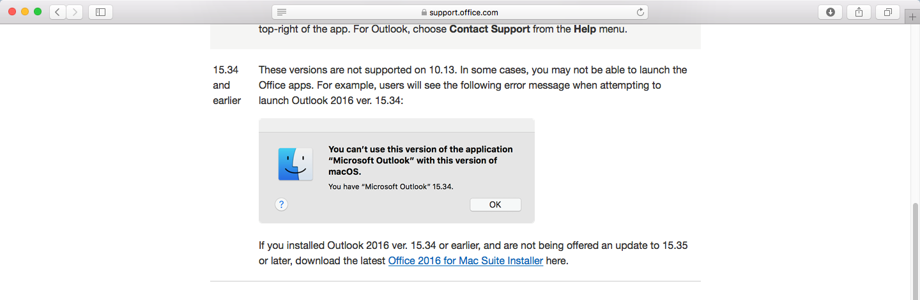
Pro-Tip: Other ways to get the Mac Installer
If for some reason you cannot download the Mac installer from customer’s account, you may download it straight from support.office.com. Just search for the keywords “High Sierra Support” or “Mojave Support”.

Slide 14
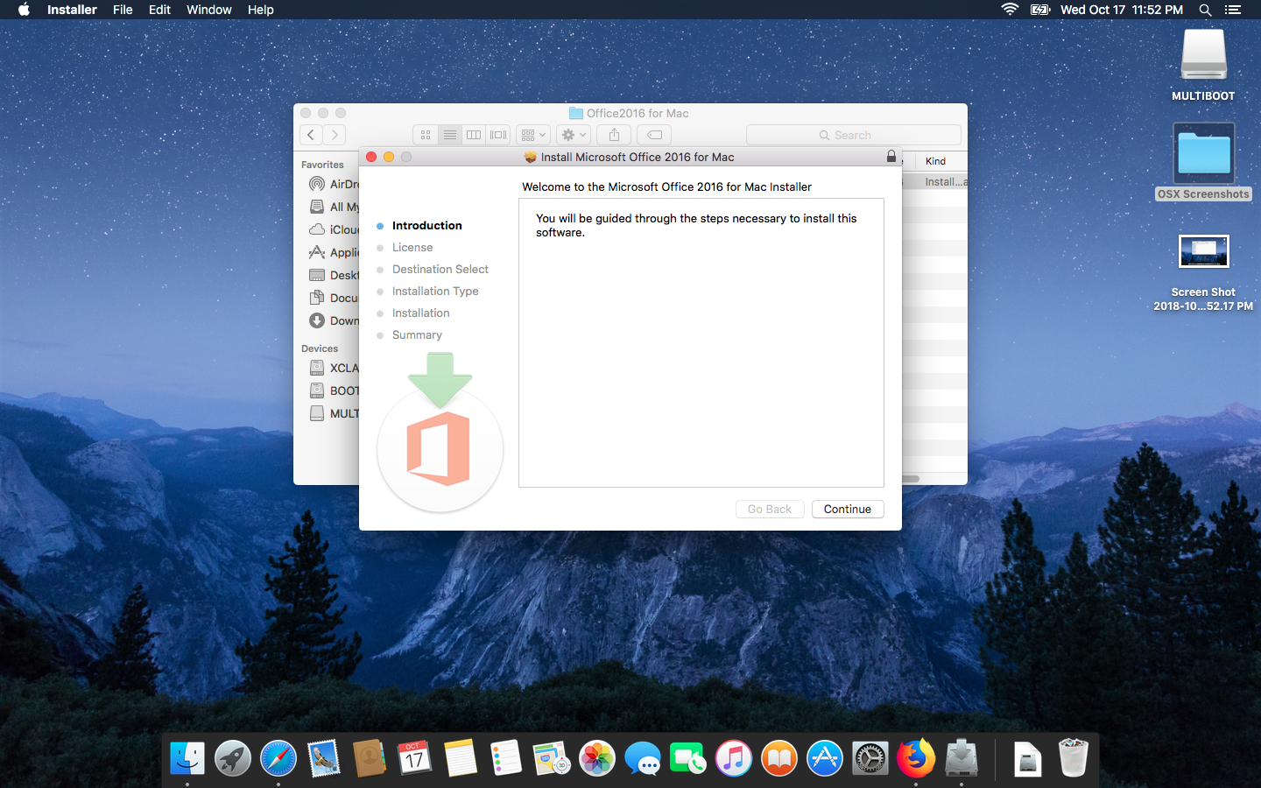
3. Run the Installer

Slide 15
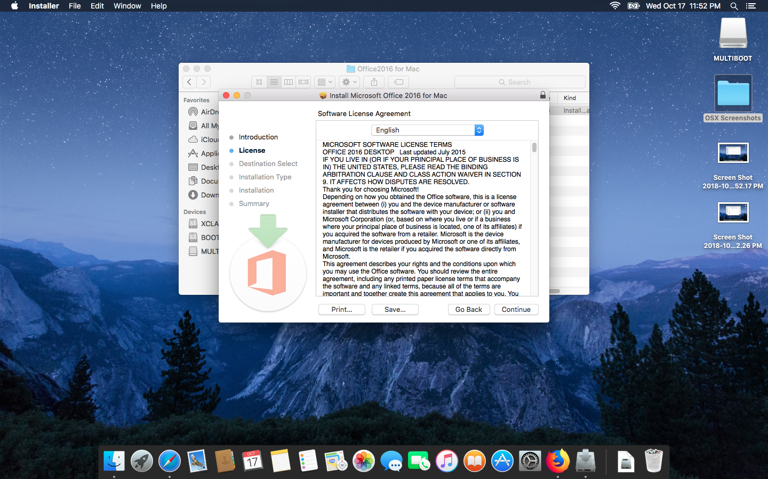
3.1 License Agreement

Slide 16
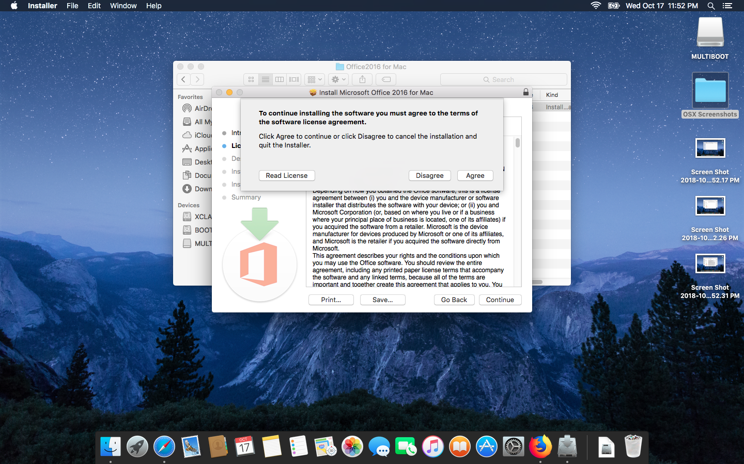
3.2 Accept Agreement

Slide 17
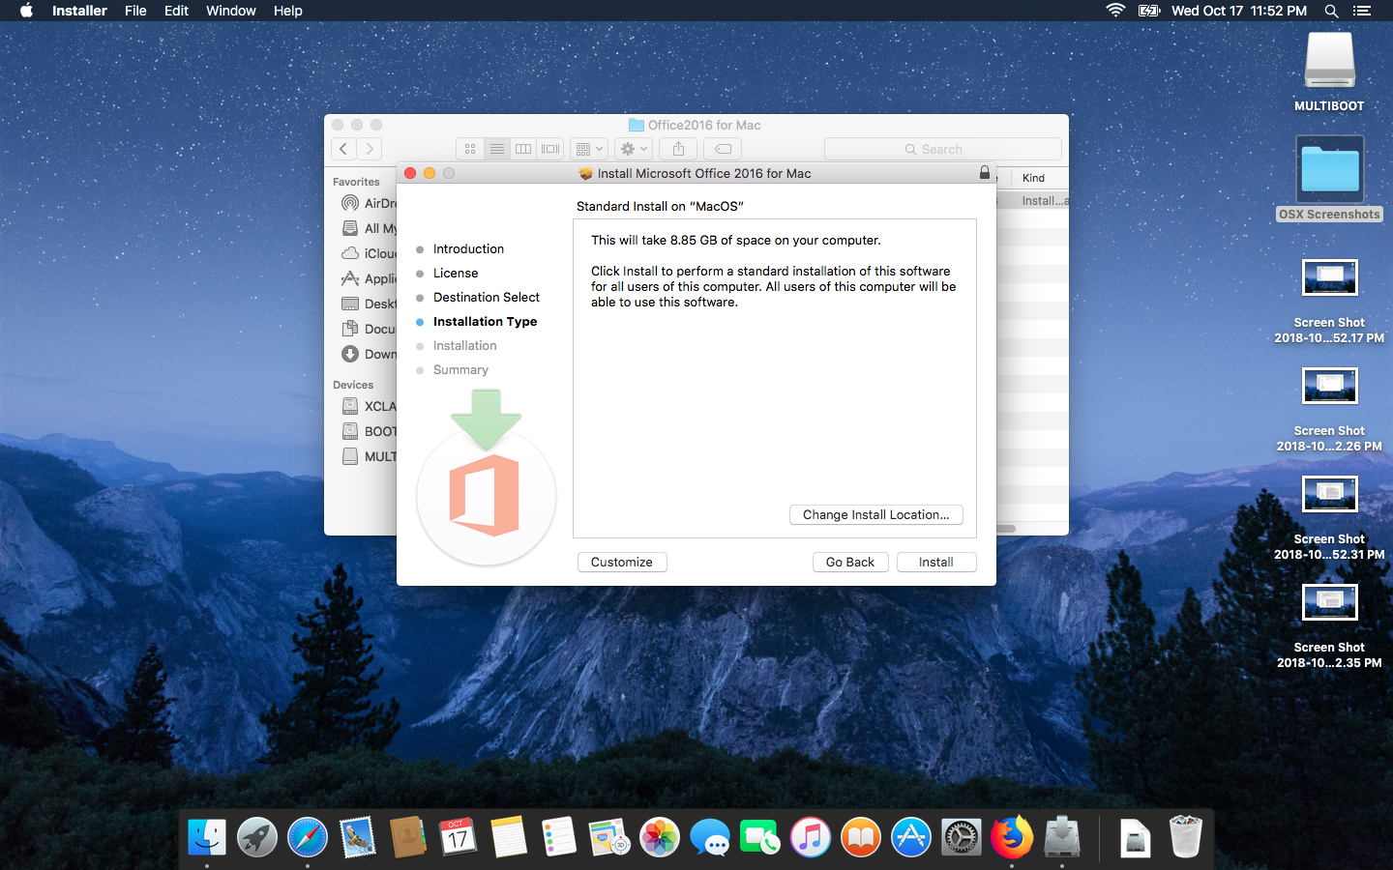
3.3 Select Install Location – Install

Slide 18
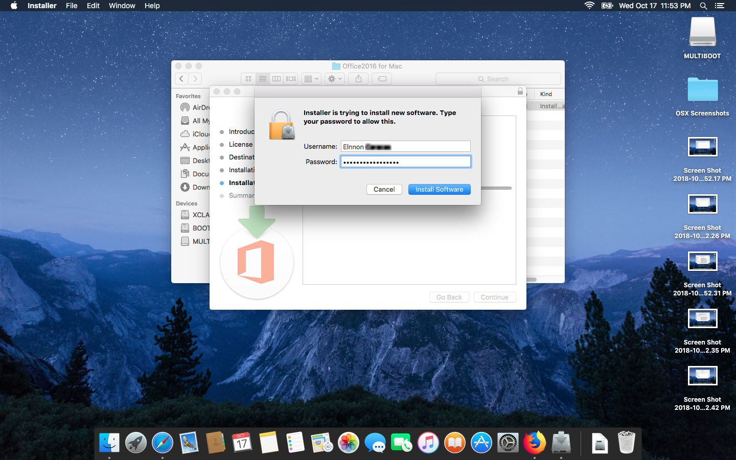
3.4 Enter Admin Password

Slide 19
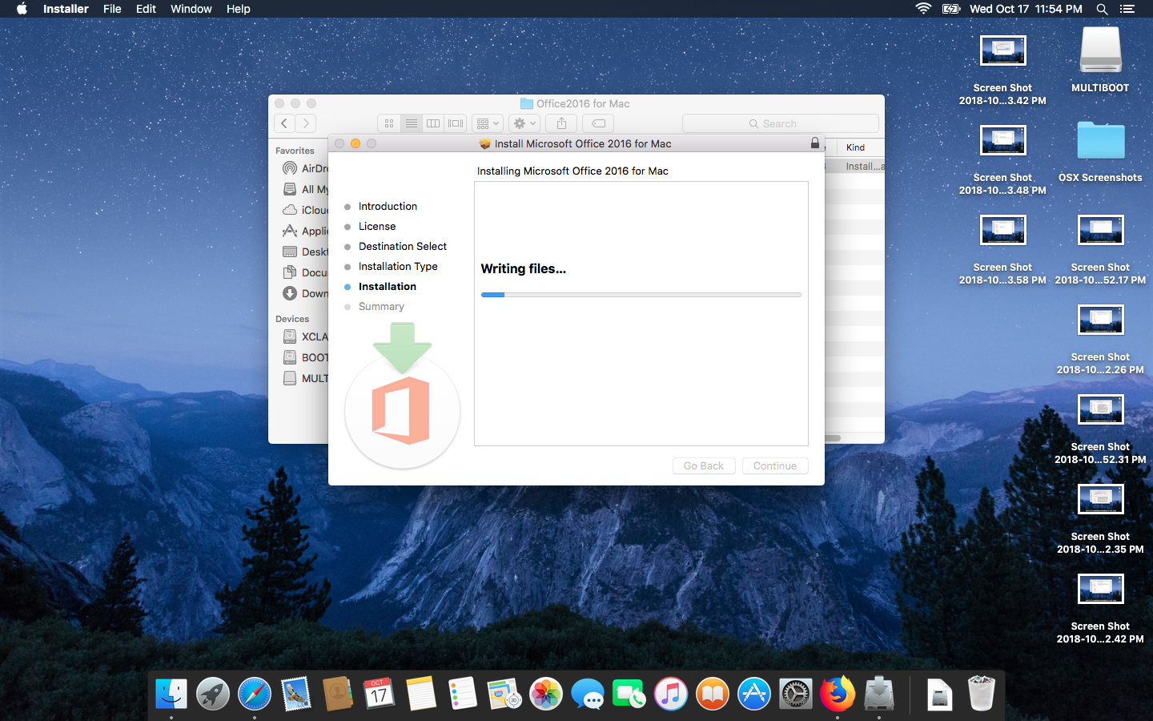
Installing.

Slide 20
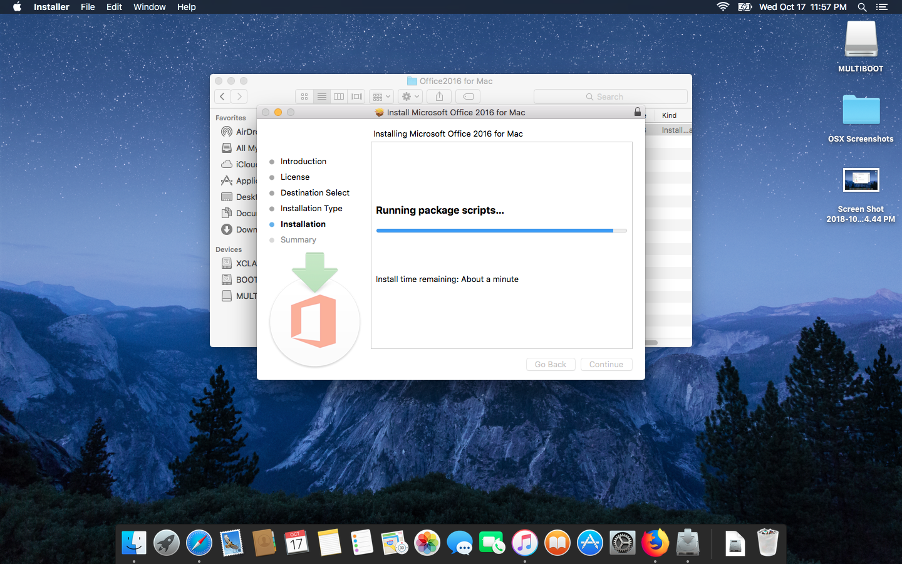
Installing..

Slide 21
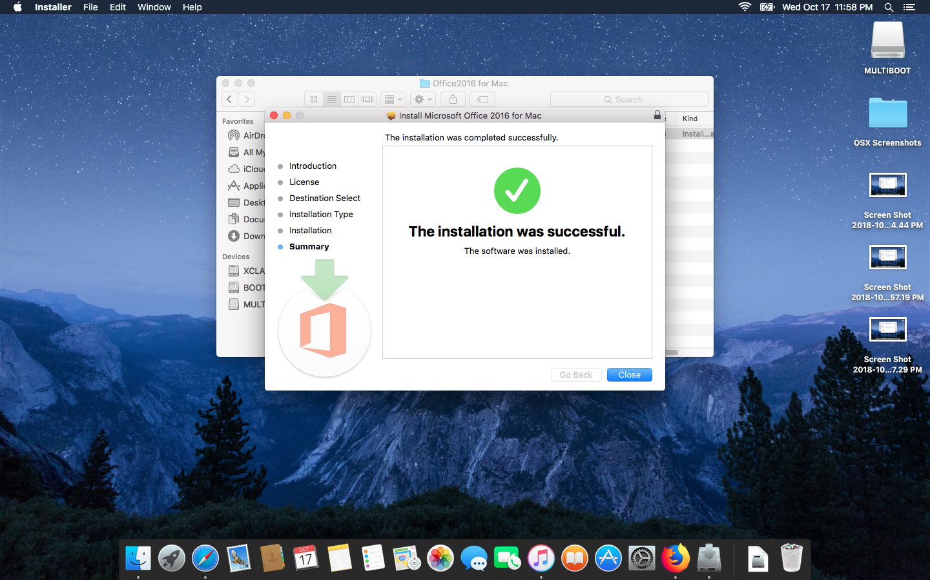
Installing… Done!

Slide 22
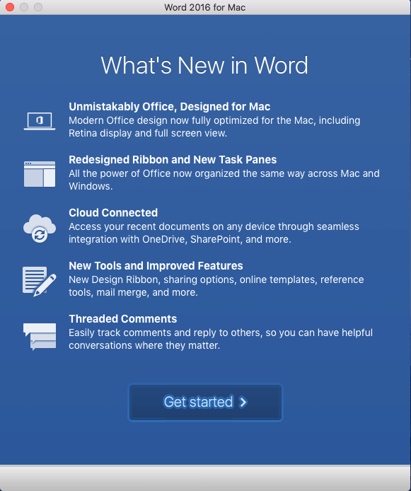
4. Activate Office
Open any Office App. The first time you run Office you will get this screen.
Click Get Started

Slide 23
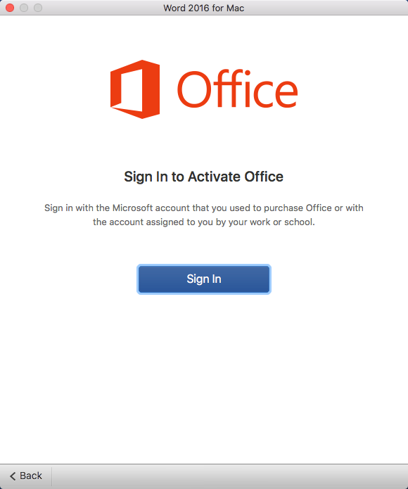
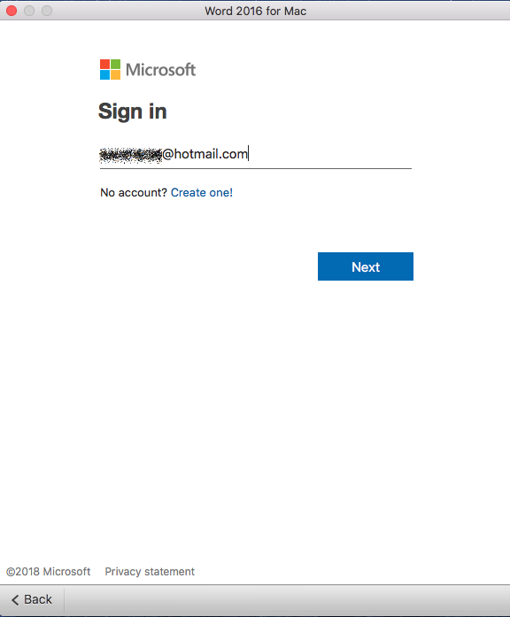
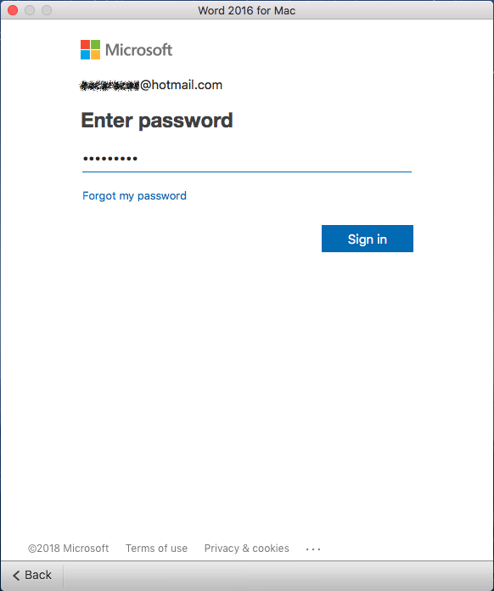
5. Sign-in to Activate

Slide 24
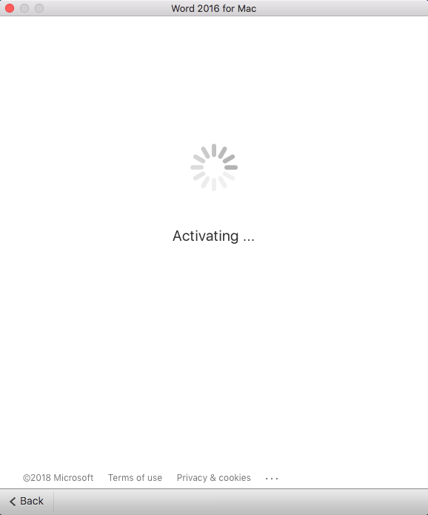
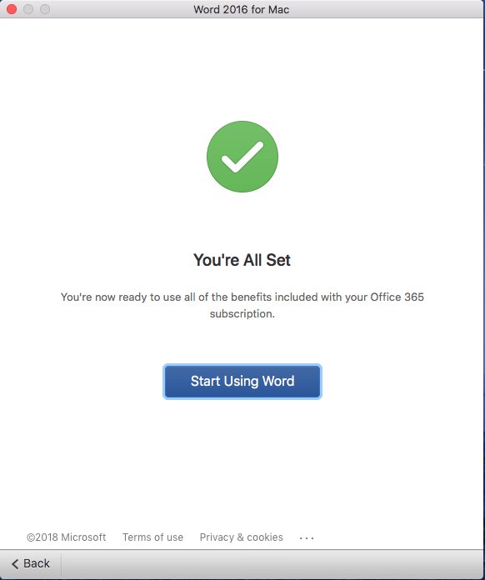
6. Profit…!

Slide 25
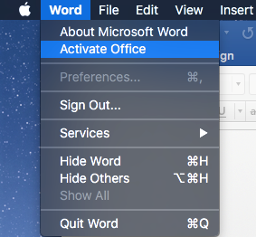
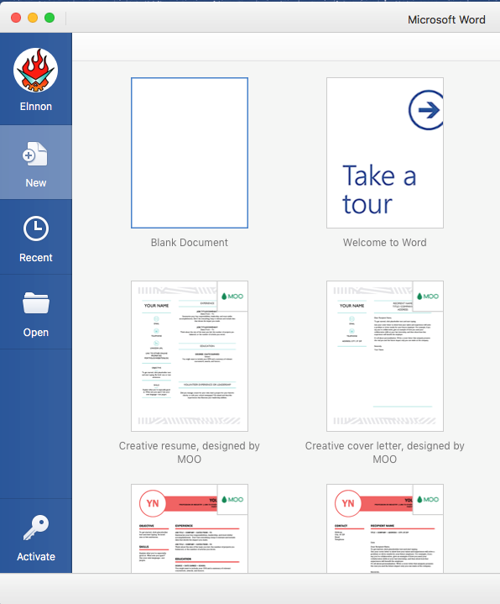
Other ways to launch the activation wizard.

Slide 26
Uninstalling Office from Mac

Slide 27
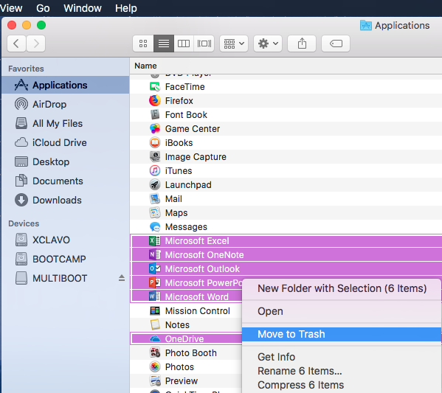
1. Trash It…!
Open Finder and open the Applications folder.
Select all the Office apps (you can do this by pressing Command + click on each app)
Right-click one of the icons selected and hit “Move to trash”
Note: If using LMI to assist a customer, the “Windows Logo” key on your keyboard acts as the Command(⌘) key.

Slide 28
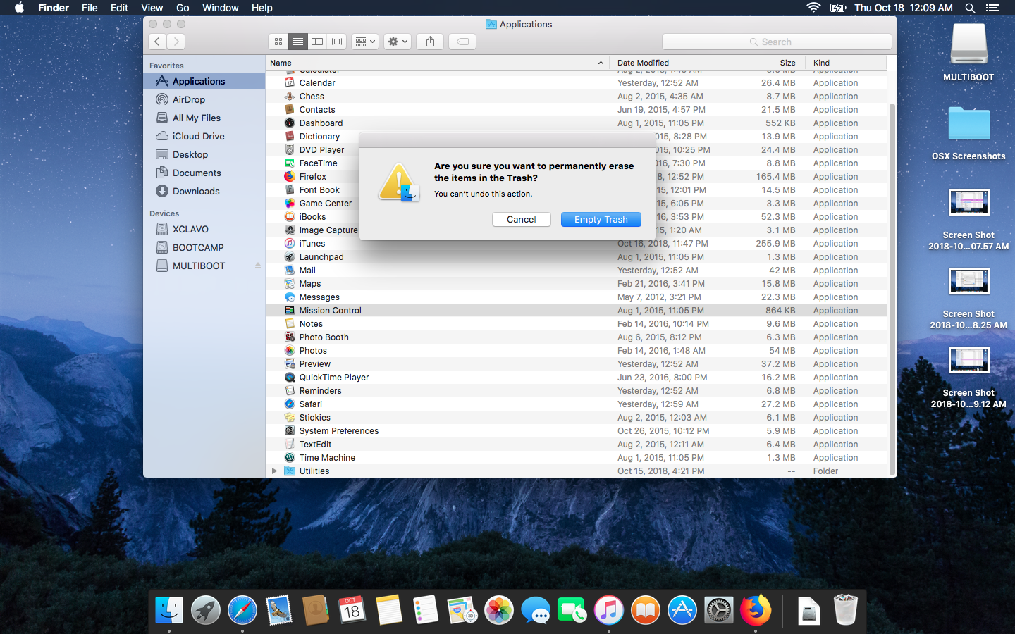
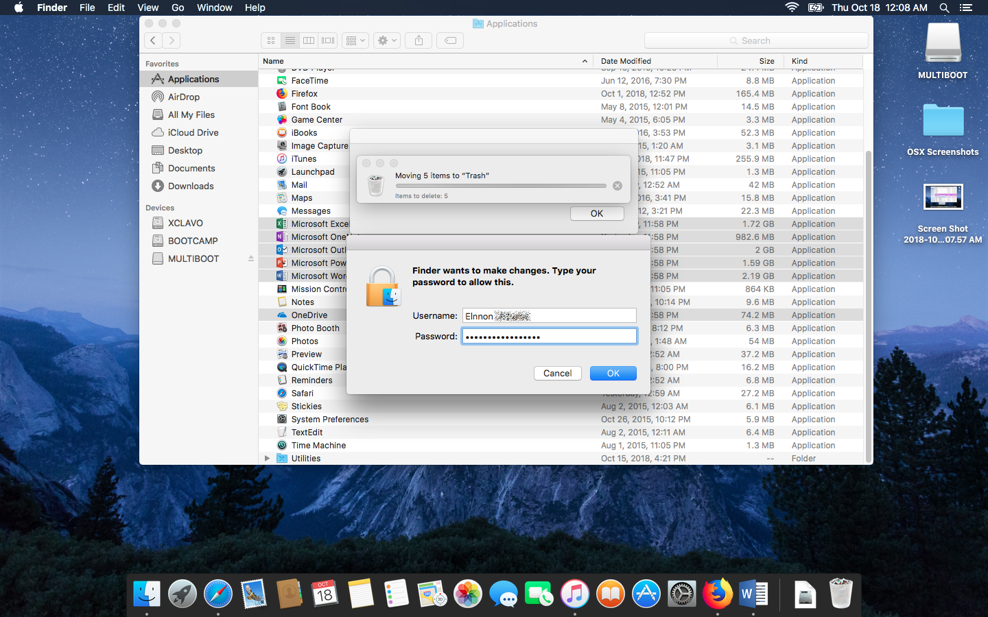
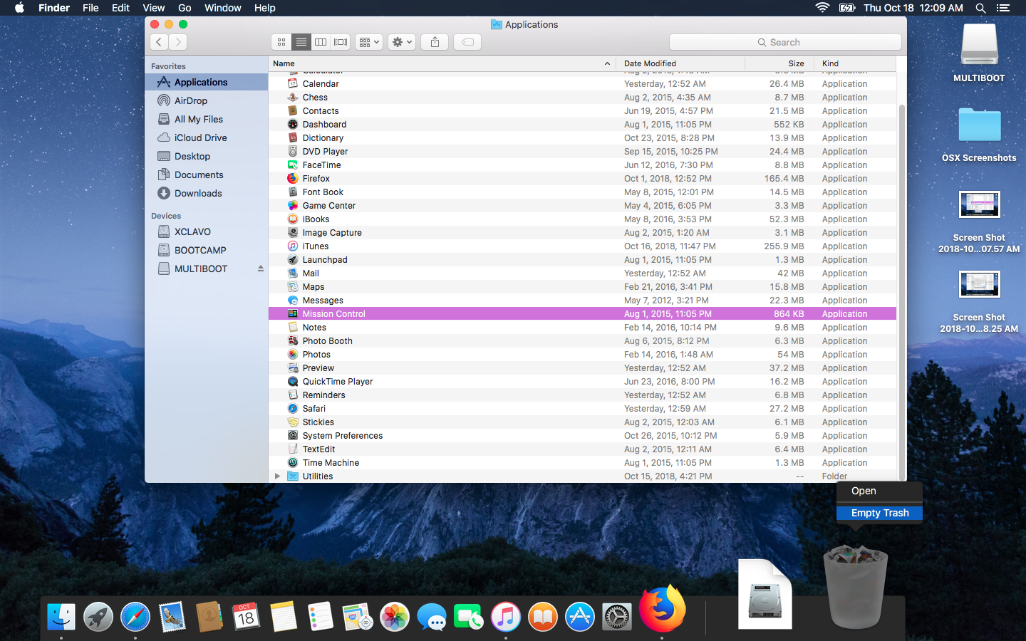
1. Trash It…!
You may be asked for the administrator’s password. Make sure customer enters it.
Empty Trash

Slide 29
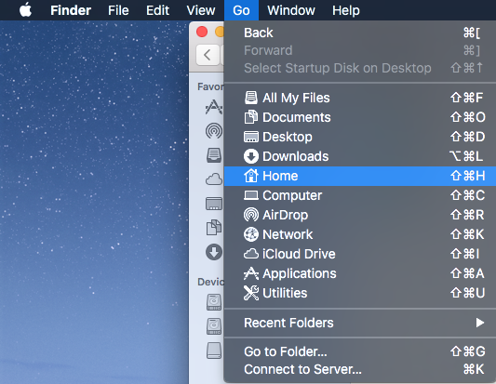
2. Purge Libraries folder
In a new Finder window press: Command(⌘) + Shift + H
This will take you to the Home folder. Another way to get there it’s through Finder’s Application Menu and selecting Go>Home

Slide 30
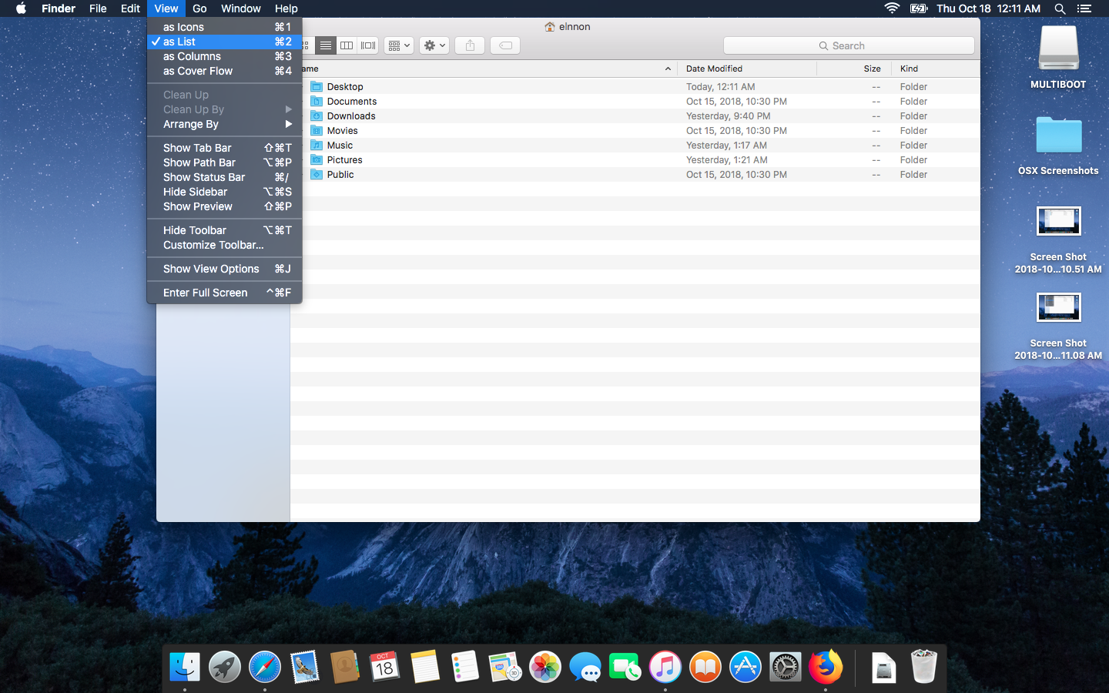
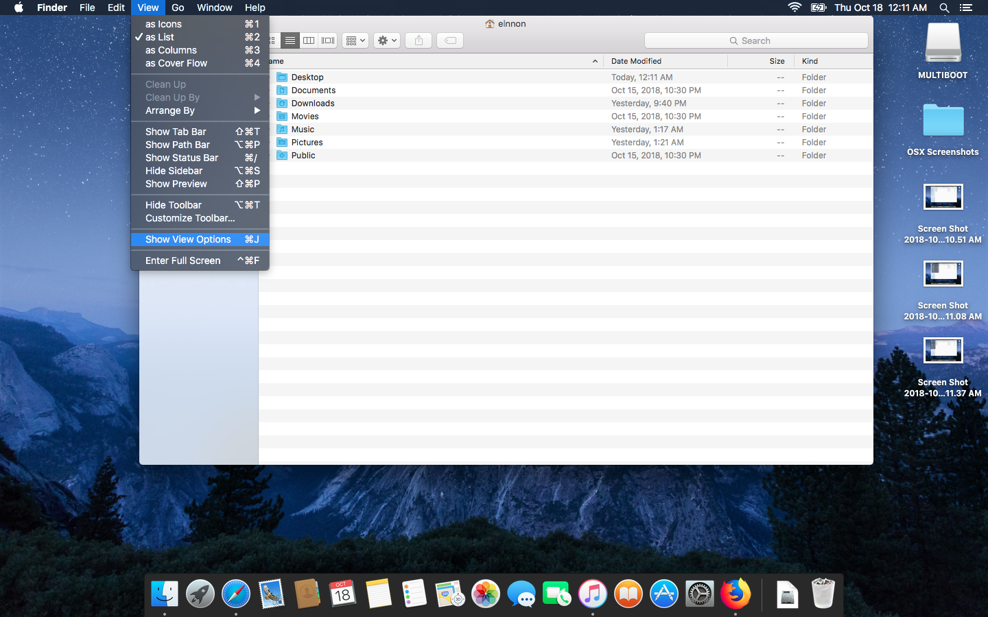
2. Purge Libraries Folder
On the Finder menu at the top, click View > as List, and then click View > Show View Options.

Slide 31
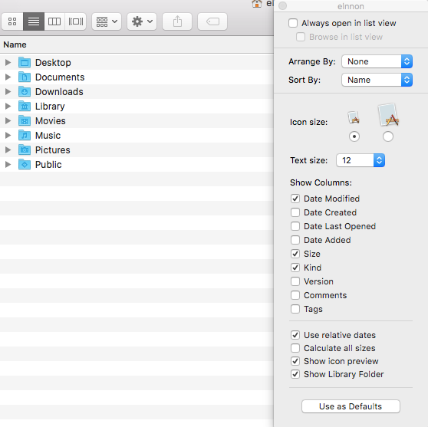
2. Purge Libraries Folder
In the View Options dialog box, select Show Library Folder and close the window.

Slide 32
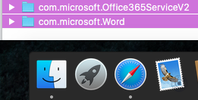
2. Purge Libraries Folder
Open Library folder and then Containers.
Move the following folders to Trash:
com.microsoft.errorreporting
com.microsoft.Excel
com.microsoft.netlib.shipassertprocess
com.microsoft.Office365ServiceV2
com.microsoft.Outlook
com.microsoft.Powerpoint
com.microsoft.RMS-XPCService
com.microsoft.Word
com.microsoft.onenote.mac
Note: Not all the folders from the list may be present. This is normal.
**Warning: Outlook data will be removed when you move these folders to Trash. Remember to backup data.

Slide 33
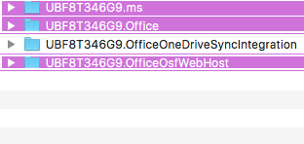
2. Purge Libraries Folder
Go back to Library folder and open Group Containers folder.
Move the following folders to Trash:
UBF8T346G9.ms
UBF8T346G9.Office
UBF8T346G9.OfficeOsfWebHost

Slide 34
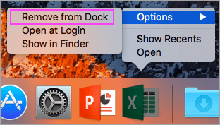
3. Clean Dock and Restart
If you put any of the Office applications in your dock, go to each one and right-click (or ctrl + click ) > Options > Remove from Dock.
Restart the Mac

Slide 35
Removal Tools for Mac

Slide 36
Removal Tools Available
Remove2011 tool (Office for Mac 2011)
License Removal Tool (Office365 for Mac, Office 2016, Office 2019)

Slide 37
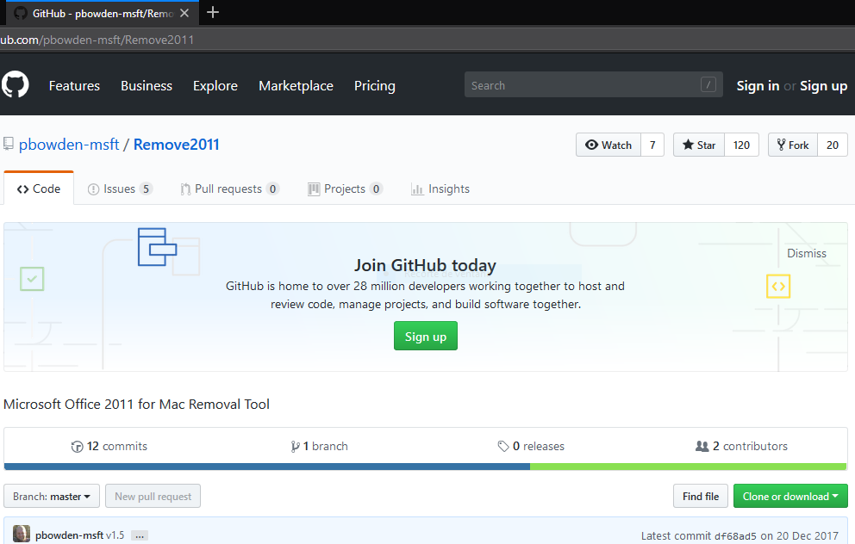
1.1 Using Remove2011 tool
Open the article “Troubleshoot Office 2011 for Mac issues by completely uninstalling before you reinstall”
Searching at support.office.com with the keywords: “remove 2011 mac” will also do the trick.
Download the tool from: https://github.com/pbowden-msft/Remove2011

Slide 38
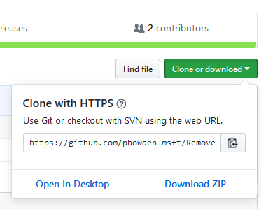
1.1.1 Download .zip file
Click on “Clone or Download”
Select “Download ZIP”

Slide 39
3. Run the Installer

Slide 40
3. Run the Installer

